Slide 1



An Expert System to Detect Privacy's Vulnerability of Social Networks
IMCET 2016
Gerges Tannous, Ph.D. Candidate, Universidad Complutense Madrid (UCM)
Aziz M. Barbar, Ph.D., Dean of Faculty of Arts & Science, American University of Science & Technology (AUST)

Slide 2
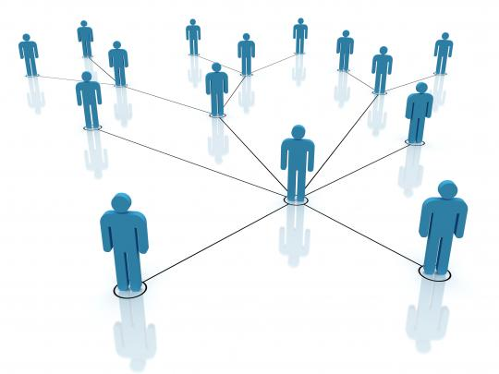

Introduction - Definition
Real Name
Age
Address
Gender

Slide 3







Introduction - Types and Users
General Purpose Networks
Niche Networks
1997
2005
2011
2007
2003
2003

Slide 4
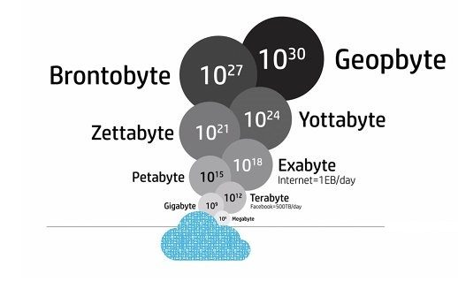

Background
3.2 Bn/Day likes and comments
300Mn/Day Photos
700 video/Min - Twitter
Locations (check-ins)
Connections
Willingly or unwillingly!

Slide 5
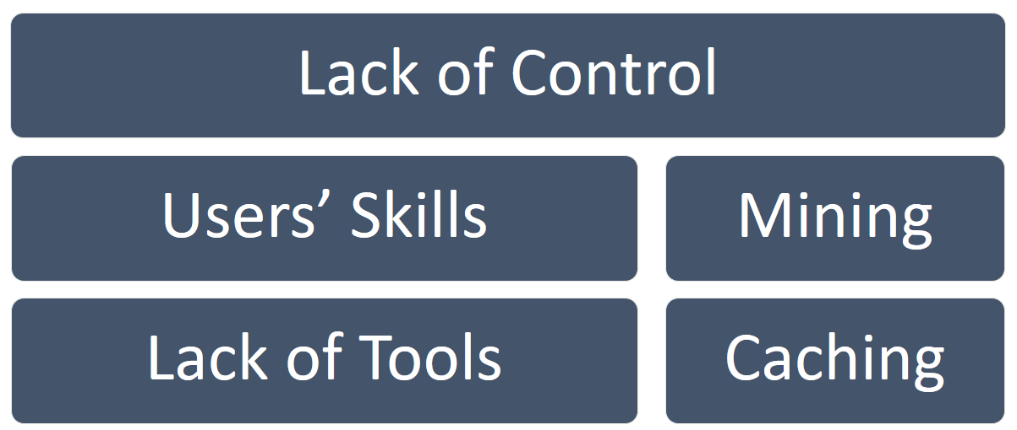
Problem

Slide 6
Existing Solutions
Location Based
By Wrenke et al
Anonymizer
Image Based
Alessandro Acquisti
Face Recognition
Connections’ Based
Joseph Bonneau
Social graph
Text Based
Michelle Zhou (IBM)
Personality Traits

Slide 7
Proposed Solution
Input 1
Input n
Consider Contextual events
Description
Location
Timing
Involved users
Use Publicly available data
Classify using fuzzy logic
Set of Rules 1
Set of Rules n
Output used as Input 1
Output used as Input 1
Set of
Fuzzy Rules 1
Result

Slide 8
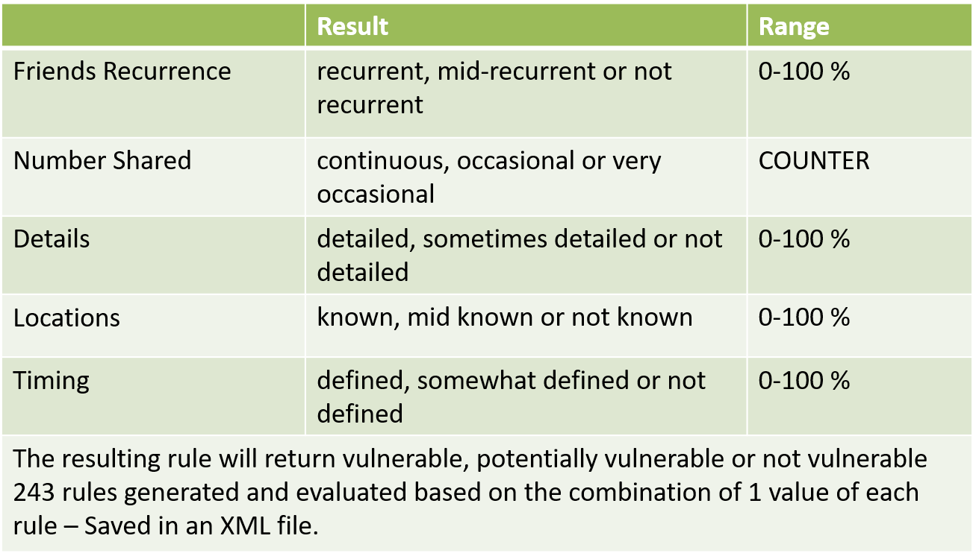
Implementation (1/4) - Fuzzy Rules

Slide 9
Implementation (2/4) - XML Rule Sample
<rules> <friends>value1</friends> <numbers>value2</numbers> <details>value3</details> <locations>value4</locations> <timings>value5</timings> <ruleResult>Result</ruleResult> </rules> “if (friends are value1) and (numbers are value2) and (details are value3) and locations are value 4) and (timings are value5) then Result”

Slide 10
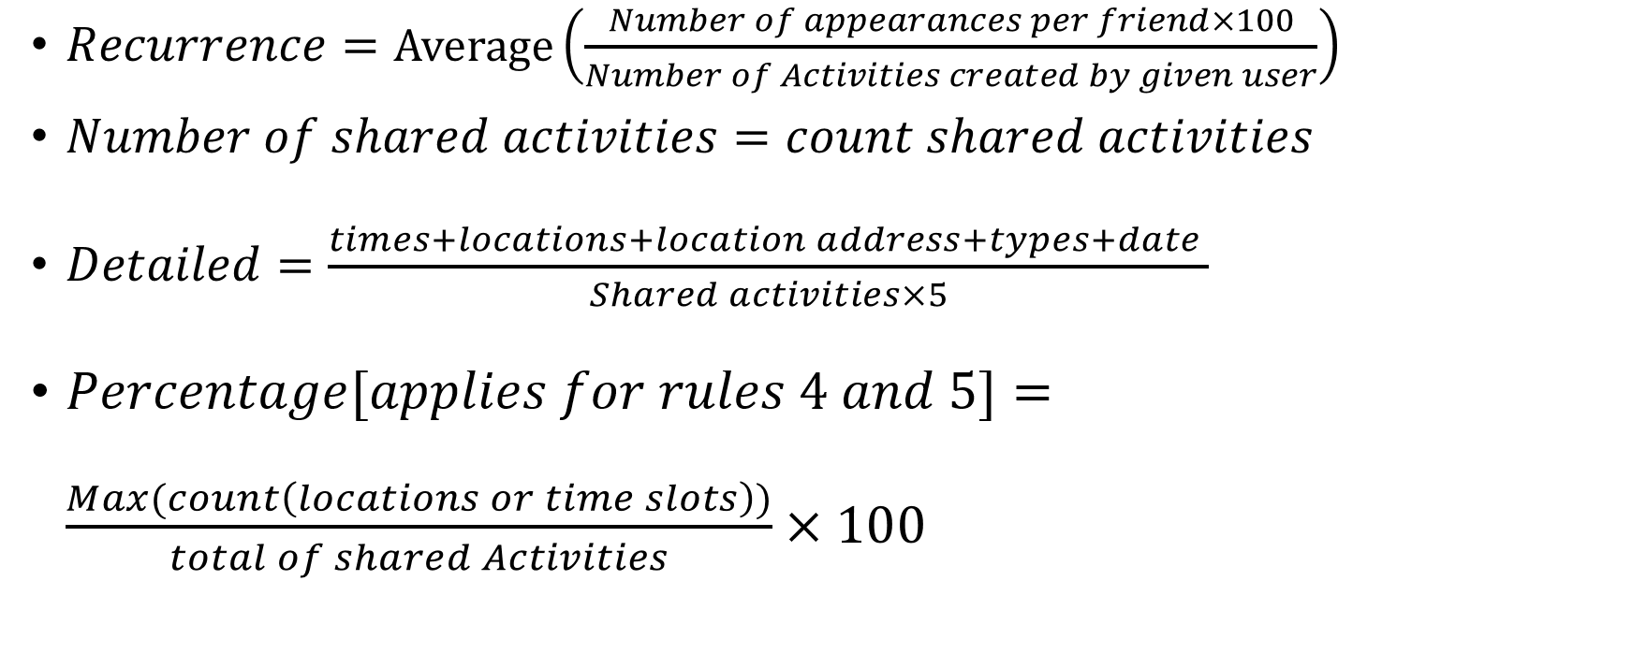
Implementation (3/4) - Formulas of Fuzzy Rules Input

Slide 11
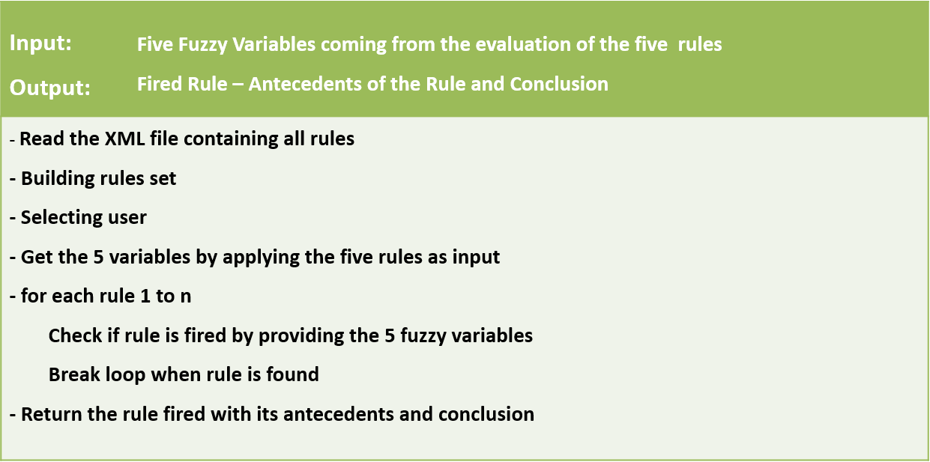
Implementation (4/4) - Expert System Algorithm
MySQL
FuzzyJ

Slide 12
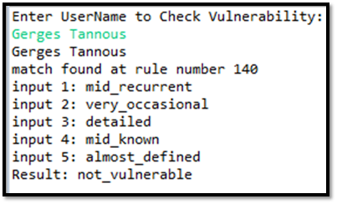
Execution
Input Values: {R1: 70}, {R2: 250}, {R3: 63}, {R4: 8}, {R5: 56} Result match found at rule number 17 input 1: recurrent input 2: continuous input 3: sometimes_detailed input 4: not_known input 5: almost_defined Final Result: potentially_vulnerable

Slide 13
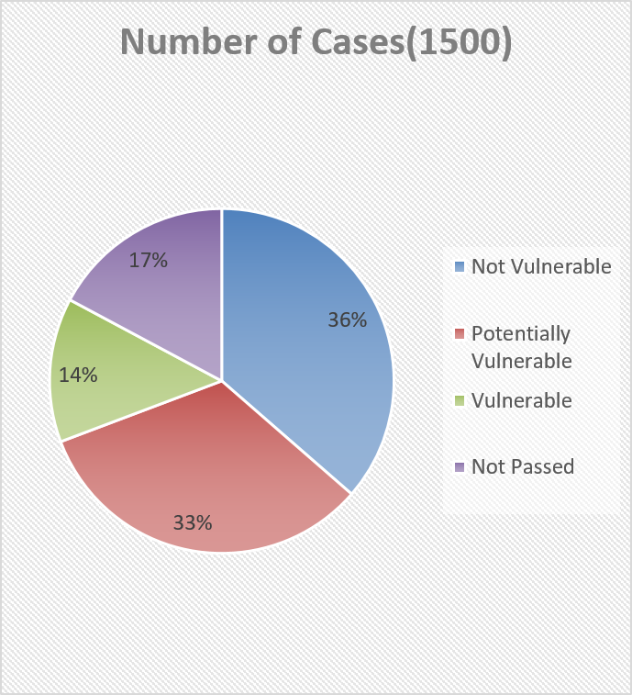
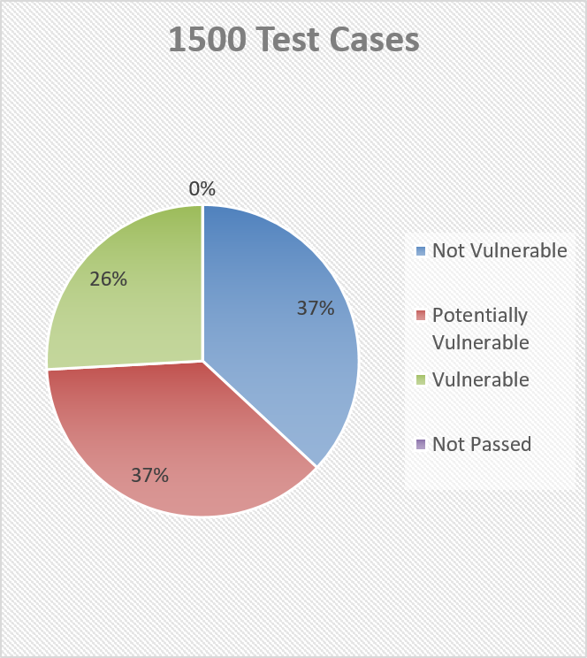
Test 1
Test 2

Slide 14
Conclusions
Future Work
More sharing means more vulnerable
Classify vulnerability using a fuzzy logic system
New Perspective for users’ privacy
Web Crawler To Collect the required data
Correlation of Users’ Vulnerability

Slide 15


Thank you!
Questions?
Gerges Tannous
Aziz M, Barbar, Ph.D.
@tannousg
abarbar@aust.edu.lb
@gtannous
gtannous@ucm.es
This presentation is a composition of text and images. The text is released as Creative Commons Attribution 4.0 International. The images are mostly copyrighted and used under Fair Use. The image logos belong to their corresponding brands/projects/institutions. Sources of other images: Wikipedia and unknown others

